Slide 1
Status Report 5/3/2022
Project Name: Skin Job
Class: DSE-I2100
Instructor: Michael Grossberg
Group Member: Gong Qi Chen, HuiHuang Liu

Slide 2
Agenda
Data Set
Missing Data
Imbalance
Data Preprocessing
Model Test
Linear and Logistic
DNN and CNN
Pre-Trained Keras Model
Future Work

Slide 3
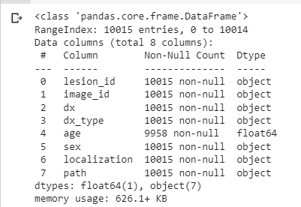
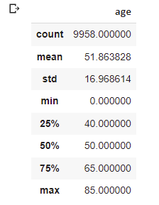
Data Set - Missing Data

Slide 4
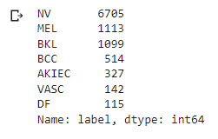
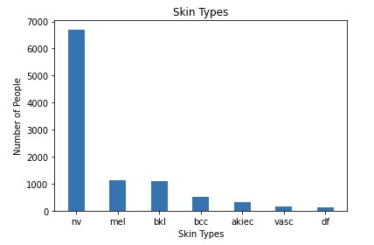
Data Set - Imbalance

Slide 5
Data Preprocessing
Data Augmentation
Achieve with keras.ImageDataGenerator()
Image Rescale
Divide by 255 to between 1 and 0
Resampling - Balancing Dataset
Reduce date with large amount
Duplicate data with smaller amount
Image Resize
Currently testing with 32x32 and 28x28
Increase the size to obtain more image detail

Slide 6
Model Test - Linear and Logistic
Accuracy:
Linear 67%
Logistic 65%
Underfitting - The structure is way too simple

Slide 7
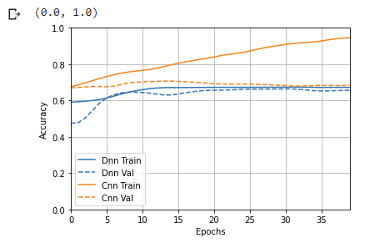
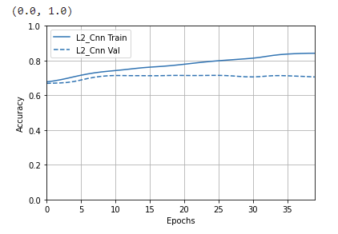
Model Test - DNN and CNN
Accuracy:
DNN: 68%
CNN: Without regularization: 68%, with regularization: 71%
DNN is underfitting - The structure is way to simple
CNN is very easy to overfit

Slide 8
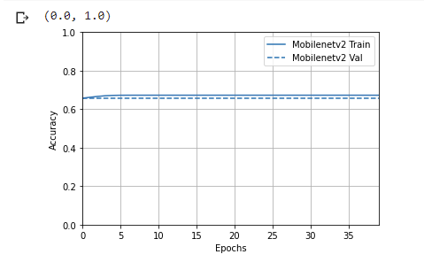
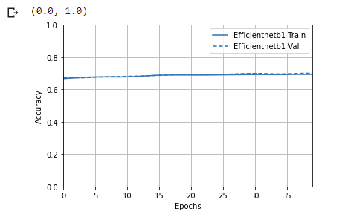
Model Test - Pre-Trained Keras Model
Accuracy:
EfficientNetB1: 70% after 40 epochs, may continue to improve with more epochs
MobileNetV2: 67% need to retest with different image size

Slide 9
Future Works
Write a recall for the Model
Reduce learning rate
Stop function
Hyper-Tuning the models
Prepare Report
Packaging the code
Documentation
Evaluate the Model with F-1 score

Slide 10
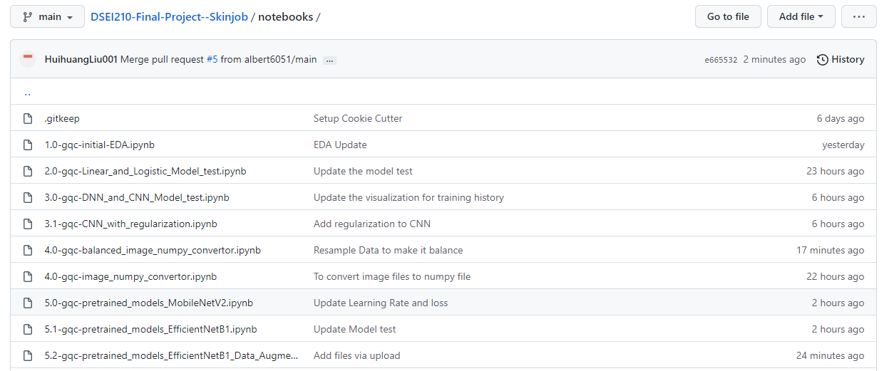
Github Notebooks

Slide 11
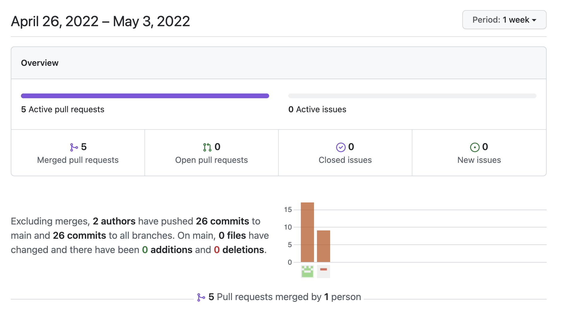
Github Commit Summary

